Slide 1
Uber Data Analytics
Modern Data Engineering Pipeline

Slide 2
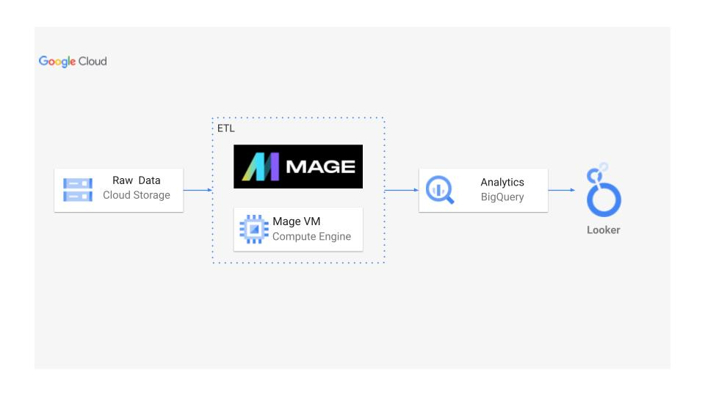
Architecture

Slide 3
Data Set Used
TLC Trip Record Data Yellow and green taxi trip records include fields capturing pick-up and drop-off dates/times, pick-up and drop-off locations, trip distances, itemized fares, rate types, payment types, and driver-reported passenger counts.
Here is the dataset used– https://github.com/Venkat185/Uber-Data-Engineering/blob/main/uber_data.csv
More info about dataset can be found here:
Website – https://www.nyc.gov/site/tlc/about/tlc-trip-record-data.page
Data Dictionary – https://www.nyc.gov/assets/tlc/downloads/pdf/data_dictionary_trip_records_yellow.pdf

Slide 4
Fact & Dimension Table
Fact Table:
Contains quantitative measures or metrics that are used for analysis
Typically contains foreign keys that link to dimension tables
Contains columns that have high cardinality and change frequently
Contains columns that are not useful for analysis by themselves, but are necessary for calculating metrics
Dimension Table:
Contains columns that describe attributes of the data being analyzed
Typically contains primary keys that link to fact tables
Contains columns that have low cardinality and don't change frequently
Contains columns that can be used for grouping or filtering data for analysis

Slide 5
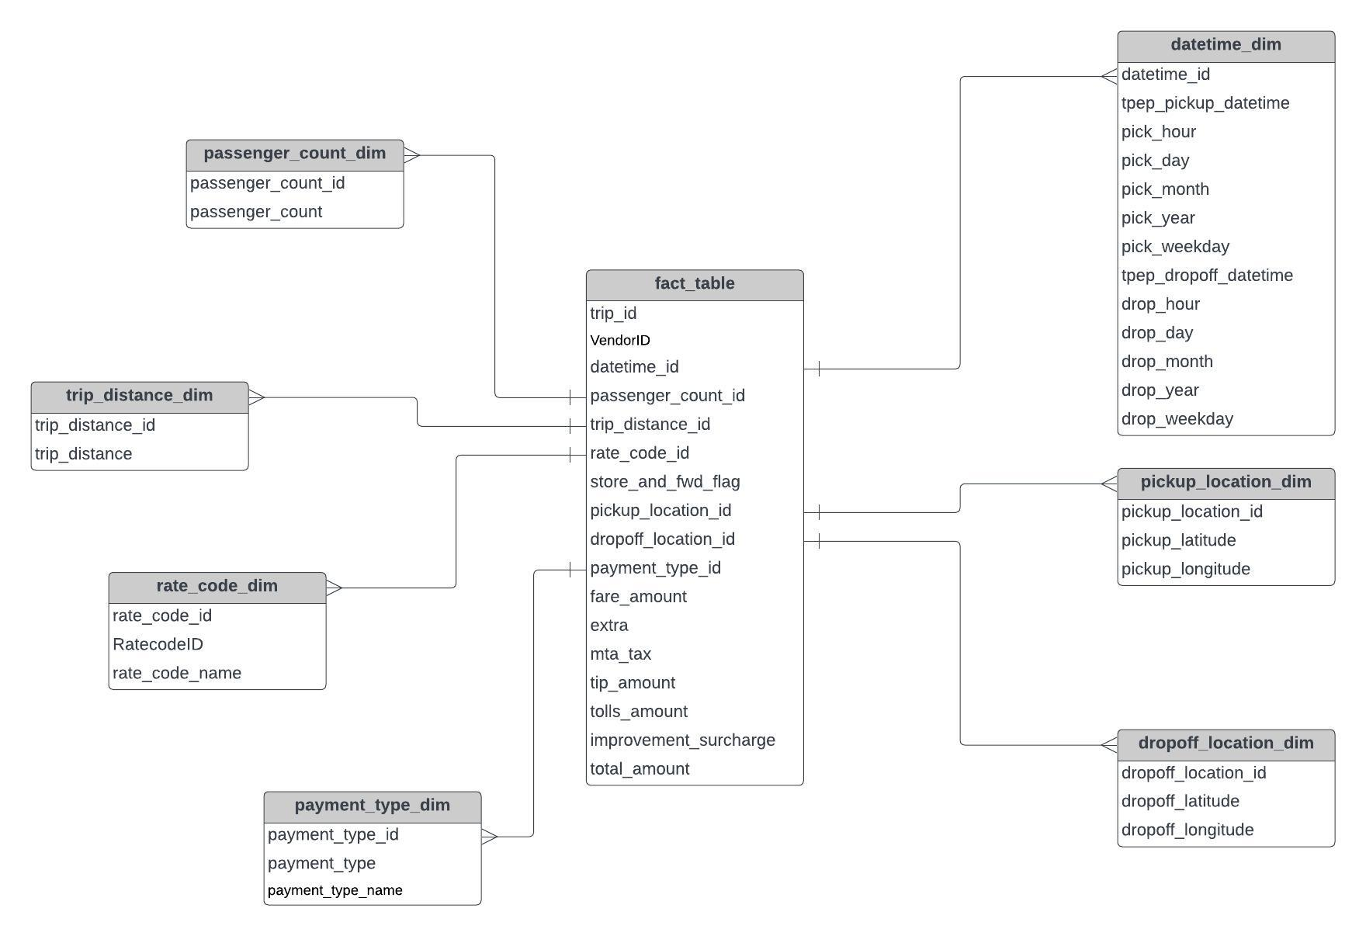
Data Model

Slide 6
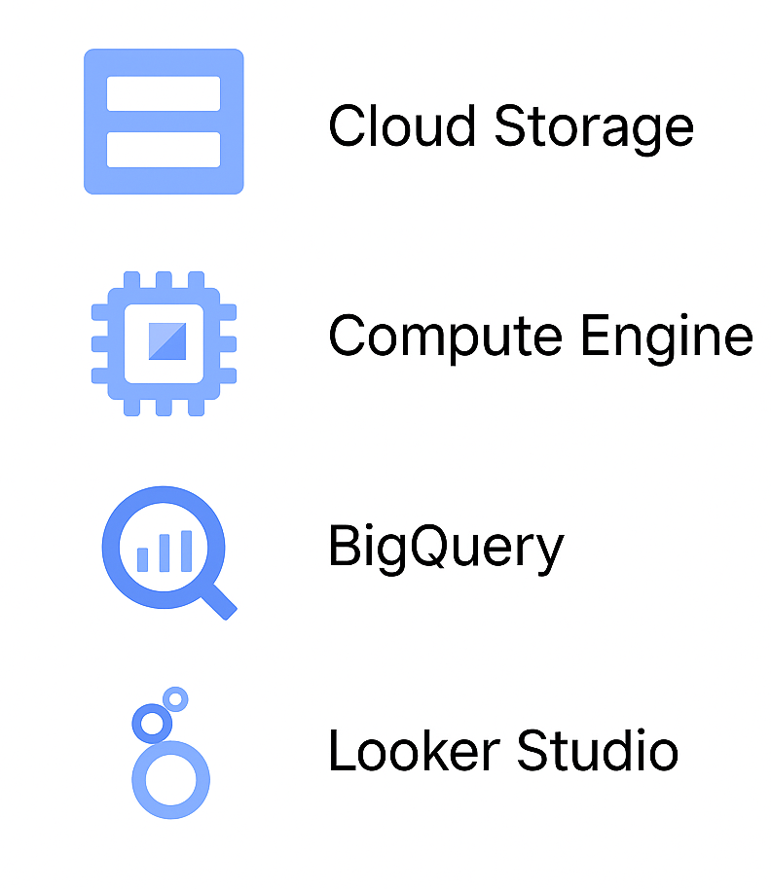
GCP Services
A service to store and retrieve data from anywhere via the internet.
Provides virtual machines to run applications and services easily.
A serverless data warehouse to store, query, and analyze large datasets quickly and cost-effectively.
A serverless data warehouse to store, query, and analyze large datasets quickly and cost-effectively.

Slide 7
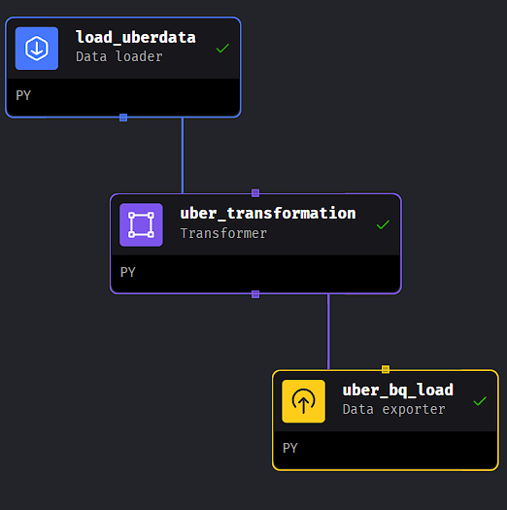
Mage
Open-source data pipeline tool for transforming and integrating data.

Slide 8
ETL Pipeline Flow
Extract: Read raw CSV from Cloud Storage or URL using Mage
Transform: Clean and restructure data (datetime, passenger count, etc.)
Load: Upload structured tables to BigQuery
Analyze: Run SQL queries and create dashboards

Slide 9
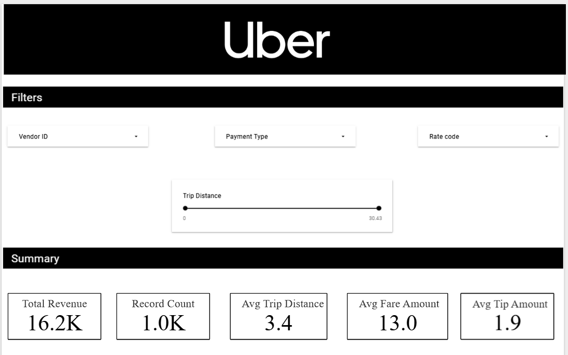
Looker Studio

Slide 10
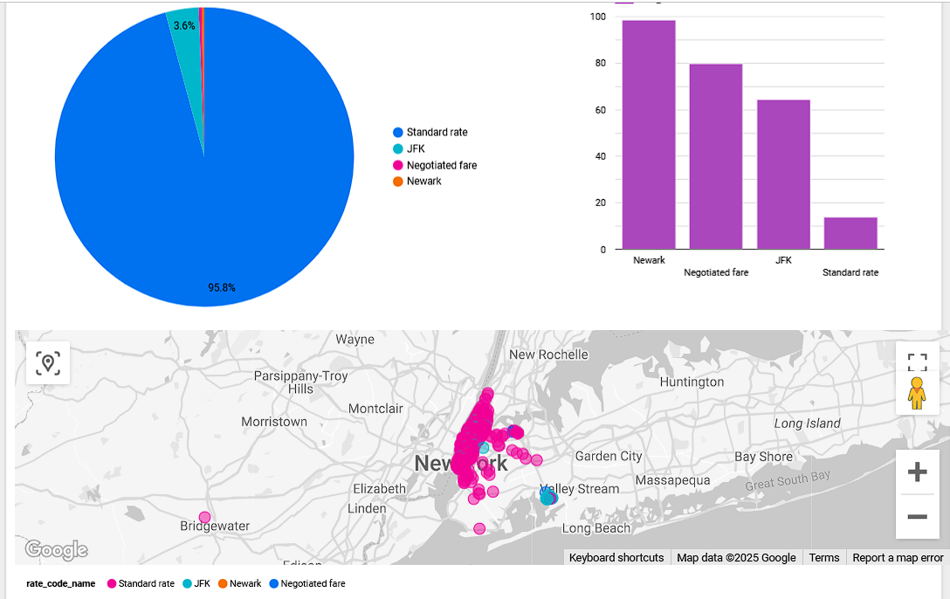

Slide 11
References
NYC Taxi and Limousine Commission (TLC) – Trip Record Data https://www.nyc.gov/site/tlc/about/tlc-trip-record-data.page
Data Dictionary – Yellow Taxi Trips https://www.nyc.gov/assets/tlc/downloads/pdf/data_dictionary_trip_records_yellow.pdf
Mage.ai – Modern Data Pipeline Tool https://www.mage.ai/
Mage.ai GitHub Repository https://github.com/mage-ai/mage-ai
Google Cloud BigQuery Documentation https://cloud.google.com/bigquery/docs
Looker Studio (formerly Google Data Studio) https://lookerstudio.google.com/
Dataset used in project (uber_data.csv) https://github.com/Venkat185/Uber-Data-Engineering/blob/main/uber_data.csv

Slide 12
THANK YOU

